Slide 1
DESIGN (ANTI-)PATTERNS
Coffee Break

Slide 2
WHAT ARE DESIGN PATTERNS

Slide 3
WHAT ARE DESIGN PATTERNS
A software design pattern is a general, reusable solution to a commonly occurring problem. It is not a finished design that can be transformed directly into source or machine code. It is a description or template for how to solve a problem that can be used in many different situations. Design patterns are formalized best practices that the programmer can use to solve common problems when designing an application or system.
HISTORY
Patterns originated as an architectural concept by Christopher Alexander (1977/78)
In 1987, Kent Beck and Ward Cunningham began experimenting with the idea of applying patterns to programming
Design patterns gained popularity in computer science after the book Design Patterns: Elements of Reusable Object-Oriented Software was published in 1994 by the so-called "Gang of Four“

Slide 4
BENEFITS OF DESIGN PATTERNS

Slide 5
BENEFITS OF DESIGN PATTERNS
A way to solve issues related to software development using a proven solution. The solution facilitates the development of highly cohesive modules with minimal coupling. They isolate the variability that may exist in the system requirements, making the overall system easier to understand and maintain.
Design patterns make communication between designers more efficient. Software professionals can immediately picture the high-level design in their heads when they refer the name of the pattern used to solve a particular issue when discussing system design.

Slide 6
SINGLETON

Slide 7
SINGLETON
GoF Definition
Ensure a class only has one instance, and provide a global point of access to it.
Concept
A class cannot have multiple instances. Once created, the next time onward, you use only the existing instance. This approach helps you restrict unnecessary object creations in a centralized system. The approach also promotes easy maintenance.
Real-World Example
Let’s assume that you are a member of a sports team, and your team is participating in a tournament. Your team needs to play against multiple opponents throughout the tournament. Before each of these matches, as per the rules of the game, the captains of the two sides must do a coin toss. If your team does not have a captain, you need to elect someone as a captain. Prior to each game and each coin toss, you may not repeat the process of electing a captain if you already nominated a person as a captain for the team. Basically, from every team member’s perspective, there should be only one captain of the team.

Slide 8
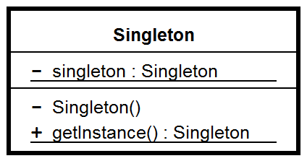
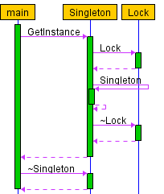
SINGLETON
UML
Clients should access a Singleton instance solely through Singleton::GetInstance( ) operation:

Slide 9
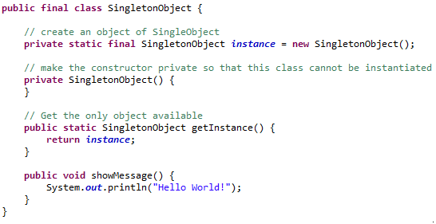
SINGLETON
Eager Initialization
The constructor is private to prevent the use of a “new” operator. The private constructor also ensures that the Captain class cannot be extended. So, subclasses cannot misuse the concept.

Slide 10
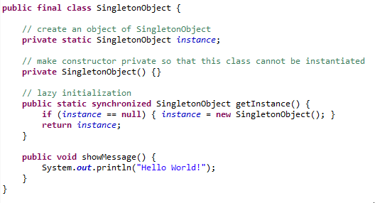
SINGLETON
Lazy Initialization
We used the “synchronized” keyword. So, multiple threads cannot involve in the instantiation process at the same time. We are forcing each thread to wait its turn to get the method, so thread- safety is ensured. But synchronization is a costly operation and once the instance is created, it is an additional overhead.

Slide 11
SINGLETON
Lazy Initialization
QUESTIONS
Is the keyword “synchronized” needed?
Why did we use the term lazy initialization?
Why are we making the class final?

Slide 12
SINGLETON
Eager Initialization
Pros?
Cons?

Slide 13
SINGLETON
Eager Initialization
Pros
It is straightforward and cleaner.
It is the opposite of lazy initialization but still thread safe.
It has a small lag time when the application is in execution mode because everything is already loaded in memory.
Cons
The application takes longer to start (compared to lazy initialization) because everything needs to be loaded first.

Slide 14
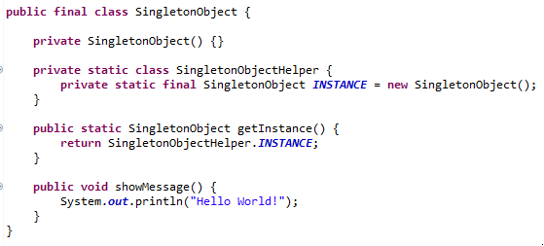
SINGLETON
Bill Pugh’s Solution
The most widely used approach for Singleton class
SingletonHelper class is not loaded into memory and only when someone calls the getInstance method, this class gets loaded and creates the Singleton class instance.

Slide 15
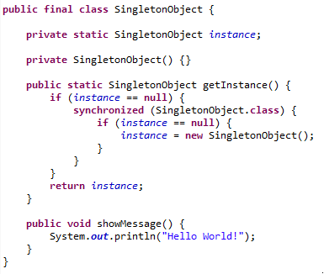
SINGLETON
Double-Checked Locking
The another popular approach
synchronization operations are costly in general, we can use a synchronized block inside an if condition

Slide 16
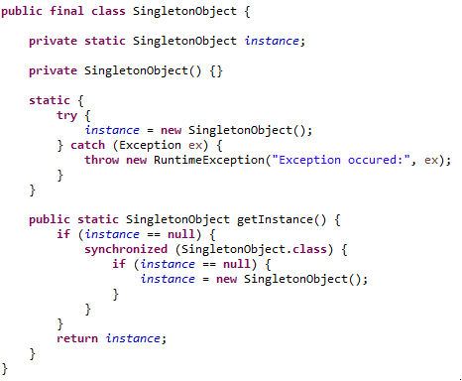
SINGLETON
Static block Initialization
Static block initialization implementation is similar to eager initialization, except that instance of class is created in the static block that provides option for exception handling.

Slide 17
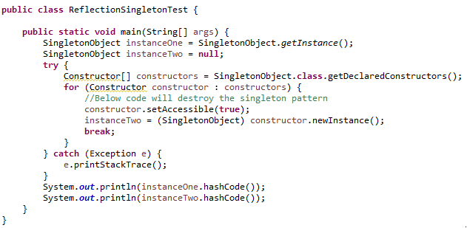
SINGLETON
Using Reflection to destroy Singleton Pattern
The hashCode of both instances is not same, we have “destroyed” the singleton pattern. Reflection is very powerful and used in a lot of frameworks like Spring and Hibernate, etc.

Slide 18
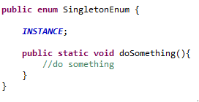
SINGLETON
Enum Singleton - To overcome this situation with Reflection

Slide 19
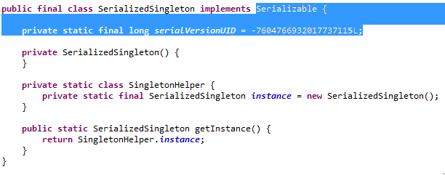
SINGLETON
Serialization and Singleton
Sometimes in distributed systems, we need to implement Serializable interface in Singleton class so that we can store its state in the file system and retrieve it at a later point of time.

Slide 20
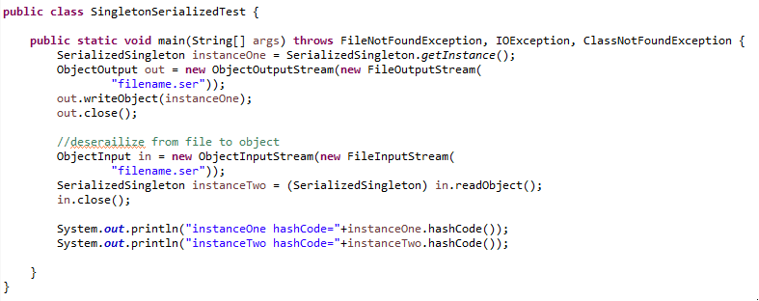
SINGLETON
Serialization and Singleton
instanceOne hashCode=865113938
instanceTwo hashCode=1283928880

Slide 21
SINGLETON
Serialization and Singleton
Java Serialization provides a special hook in the form of method “protected Object readResolve()” which decides what object is returned by serialization. In order to achieve that classes must implement this special method readResolve() and when private method on the class being instantiated, readResolve() is called before returing object and from this method object returned can be overwritten and controlled which object should be returned.

Slide 22
SINGLETON
Questions
Why are multiple object creations a big concern?

Slide 23
SINGLETON
Questions
Why are multiple object creations a big concern?
In real-world scenarios, object creations are treated as costly operations.
Sometimes you need to implement a centralized system for easy maintenance, because it can help you provide a global access mechanism.

Slide 24
SINGLETON
Questions
Why are multiple object creations a big concern?
In real-world scenarios, object creations are treated as costly operations.
Sometimes you need to implement a centralized system for easy maintenance, because it can help you provide a global access mechanism.
When should I consider singleton patterns?

Slide 25
SINGLETON
Questions
Why are multiple object creations a big concern?
In real-world scenarios, object creations are treated as costly operations.
Sometimes you need to implement a centralized system for easy maintenance, because it can help you provide a global access mechanism.
When should I consider singleton patterns?
Use of a pattern depends on particular use cases. But in general, you can consider singleton patterns to implement a centralized management system, to maintain a common log file, to maintain thread pools in a multithreaded environment, to implement caching mechanism or device drivers, and so forth.

Slide 26
SINGLETON
Questions
Why are multiple object creations a big concern?
In real-world scenarios, object creations are treated as costly operations.
Sometimes you need to implement a centralized system for easy maintenance, because it can help you provide a global access mechanism.
When should I consider singleton patterns?
Use of a pattern depends on particular use cases. But in general, you can consider singleton patterns to implement a centralized management system, to maintain a common log file, to maintain thread pools in a multithreaded environment, to implement caching mechanism or device drivers, and so forth.
What are the key characteristics of Singleton?

Slide 27
SINGLETON
Questions
Why are multiple object creations a big concern?
In real-world scenarios, object creations are treated as costly operations.
Sometimes you need to implement a centralized system for easy maintenance, because it can help you provide a global access mechanism.
When should I consider singleton patterns?
Use of a pattern depends on particular use cases. But in general, you can consider singleton patterns to implement a centralized management system, to maintain a common log file, to maintain thread pools in a multithreaded environment, to implement caching mechanism or device drivers, and so forth.
What are the key characteristics of Singleton?
The constructor is private
Create an instance at most once, reuse existing one if possible

